Slide 1
Defensive Driving
Notes:
Thank you for including me…
My background – over 25 years of commercial Property and Casualty insurance experience, specializing in marketing, product development, and the utilization of client-facing technologies.
Began career with Willis, then was with Sedgwick which became Marsh, then spent the last 15 years with WGA and came into Gallagher as a merger partner in 2015.
Beyond all my marketing years, I was a producer while at Marsh and when I started at WGA, making me uniquely qualified to know what it takes for all of you to get the kind of opportunities I want to work on with you.

Slide 2
Defensive Driving
Defensive driving is driving to save lives, time and money, in spite of the conditions around you and the actions of others.
Defensive driving is the responsibility of everyone who operates a vehicle in our roadway community.

Slide 3
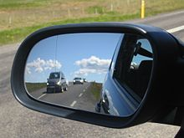
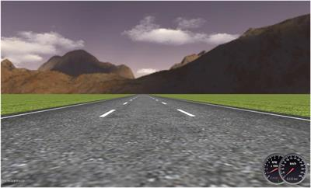
The DDC Collision Prevention Formula:
Recognize the hazard
Scan ahead and around your vehicle
Check mirrors every 3-5 seconds
Always stay alert
Use the “what if” strategy to keep you alert

Slide 4
Understand the Defense
Know what to do to prevent a traffic hazard from becoming a collision
Know the consequences of your driving choices
Know the basic defenses of:
Scanning in all directions
SLOW DOWN
Use a safe following distance

Slide 5
Act Correctly – Act In Time
Choose the safest driving maneuver to prevent a collision
Remember ---- Other drivers may act in time, but they may act incorrectly.

Slide 6
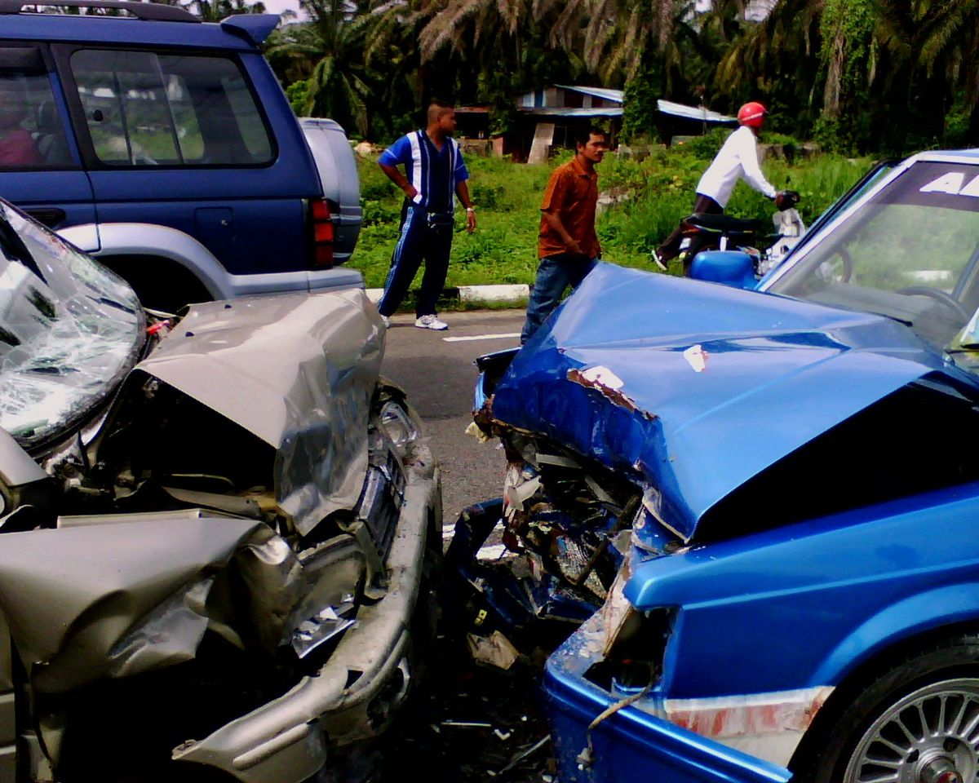
Preventable Collision
A PREVENTABLE COLLISION is a collision which the driver fails to do everything REASONABLE to avoid the accident.

Slide 7
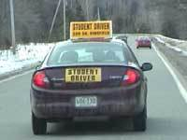
What Are Your Driving Behaviors?
Do you drive the posted speed limit regardless of what the traffic is doing and how fast it is going?
Do you plan ahead for weather conditions and construction hazards when planning your daily routes?
Do you alert other drivers to your actions using your turn signals?
Do you wear a safety belt and require all passengers to do the same while in a vehicle?
Do you practice safe driving behavior by not talking on the cell phone or texting?

Slide 8
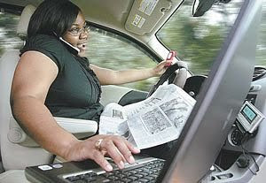
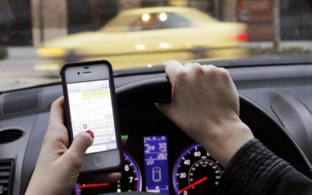
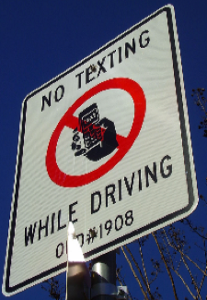
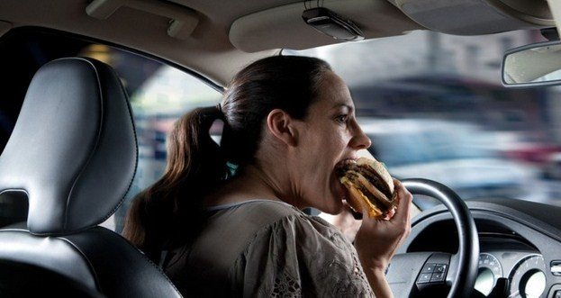
Distracted and Impaired Driving
What examples do you have?

Slide 9
Distracted and Impaired Driving
Eating in the car
Talking on the phone
Texting
Putting on make-up
Shaving
Reading the paper
Thinking about things other than driving
Reaching for other things in the car
Reading a map
Cleaning the inside of the window
Changing clothes

Slide 10
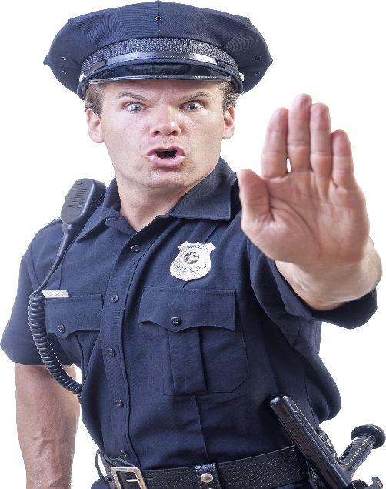
Responsibilities of Drivers
Register and license your vehicle
Vehicle maintenance
Hold an appropriate driver’s license
Automobile insurance availability
Refrain from driving if you have any type of disability or impairment that would affect driving
Wear appropriate eyewear
Understand and follow the rules of the road
Operate a vehicle safely
When involved in a collision - stop at the scene and follow your organizations reporting rules

Slide 11
Conditions In Roadway
Work zones
Light and weather
Traffic
Blind spots of semis
Emergency vehicles
Mover over law
School buses
Trains
Slow-moving vehicles
Pedestrians
Motorcycles
Bicyclists
Animals

Slide 12
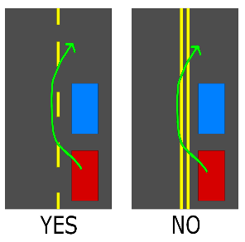
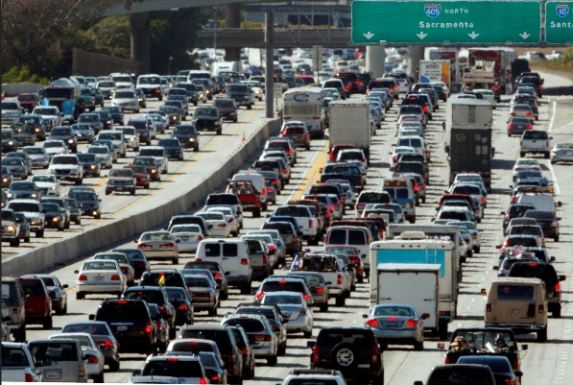
Fatal Four Driving Behaviors
Speeding
Right of Way
Driving left of center
Tailgating/following too closely

Slide 13
The Three Second-Plus Rule
For every poor condition, add 1 more second of following distance to the baseline of 3 seconds.
For rain or ice - add 2+ seconds

Slide 14
Remember Your World and Our Roadway Community
No one wants to lose someone important to them
YOUR driving choices - including a choice to be a defensive driver - will have lifelong consequences for you, your loved ones and those around you!!!!

