Slide 1
Avoiding Rear-End
Collisions
Notes:
Thank you for including me…
My background – over 25 years of commercial Property and Casualty insurance experience, specializing in marketing, product development, and the utilization of client-facing technologies.
Began career with Willis, then was with Sedgwick which became Marsh, then spent the last 15 years with WGA and came into Gallagher as a merger partner in 2015.
Beyond all my marketing years, I was a producer while at Marsh and when I started at WGA, making me uniquely qualified to know what it takes for all of you to get the kind of opportunities I want to work on with you.

Slide 2
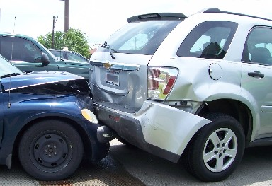
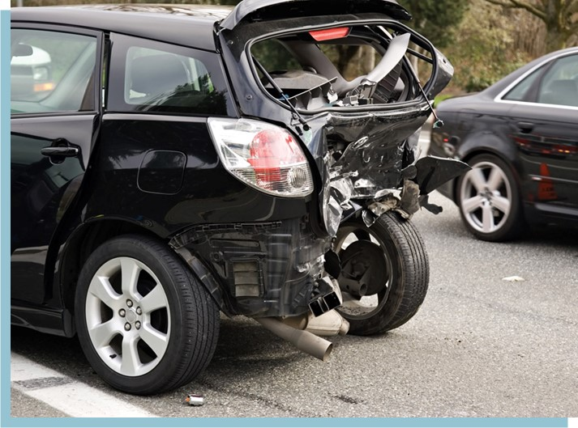
Rear – End Accident Avoidance

Slide 3
Rear-end Accident Contributing Factors
Distractions
Speeding or driving too fast for conditions
Inadequate following distance
Driver fatigue
Securing & Positioning Load (trailers)
Mechanical breakdown

Slide 4
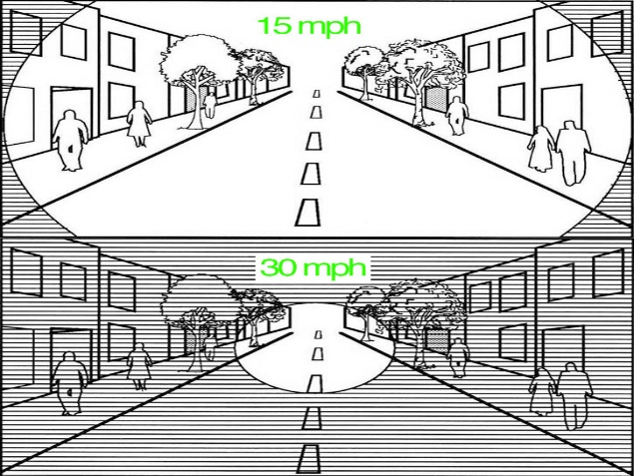
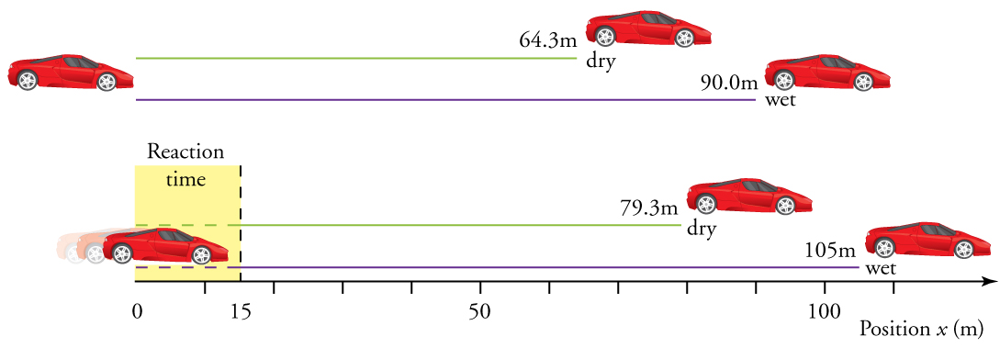
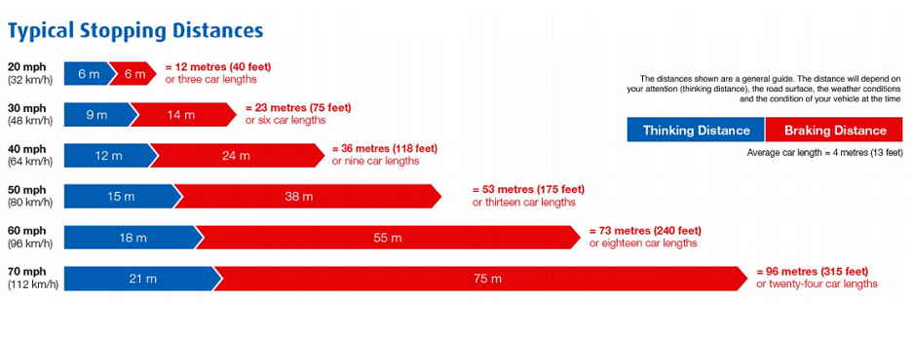
“Be Aware Distances”
Perception
Reaction
Braking
210 ft
325 ft
260 ft
345 ft

Slide 5
Perception Distance
Be aware of perception distance: the number of feet your vehicle travels from the time an event occurs, such as brake lights ahead, until you see and recognize it.

Slide 6
Reaction Distance
Be aware of reaction distance: the number of feet your vehicle travels from the time you recognize the hazard and when you brake.
210 ft
295 ft
260 ft
345 ft

Slide 7
Braking Distance
Be aware of braking distance: the number of feet your vehicle travels from the time you brake and when your vehicle stops is braking distance.

Slide 8
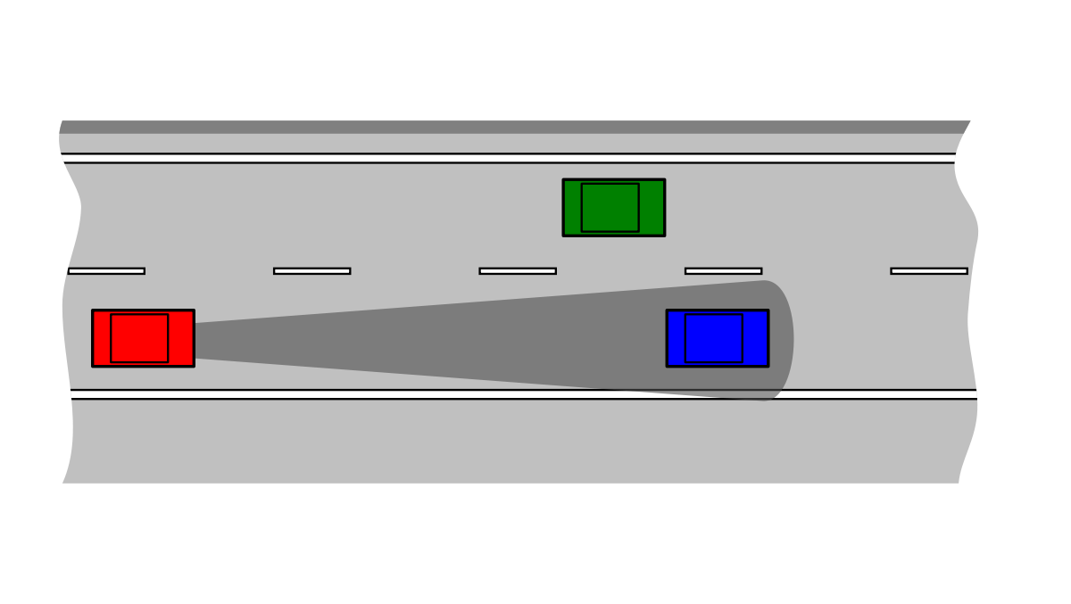
Tips to avoid rear-end accidents
Maintain a safe following distance: ( 2-4 sec between vehicles)
Stay alert and prepared: Ready to react, foot off of accelerator ready to apply brake
Scan and anticipate: Look far ahead, watch for brake lights, changing traffic signal, pedestrians, emergency vehicles etc.

Slide 9
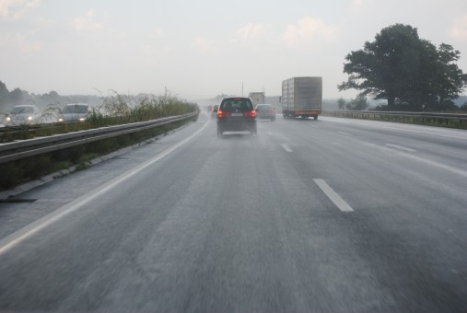
Tips to avoid rear-end accidents- cont’d.
Plan your trip: Monitor weather, traffic reports.
Consider road conditions: Increase following distance during adverse weather.
Slow down in advance of intersections: Previous vehicles may have leaked fluids; rain; snow - they all can make the road slick.

Slide 10
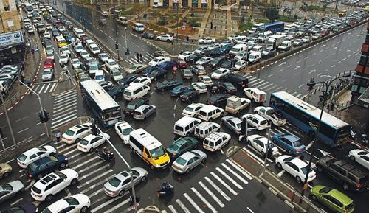
Tips to avoid rear-end accidents- cont’d.
Avoid stopping too closely to the vehicle in front of you at intersections: Keep at least one car length between your car and other vehicles.
Yellow lights mean caution: Don’t assume vehicle in front of you is going through the intersection.

Slide 11
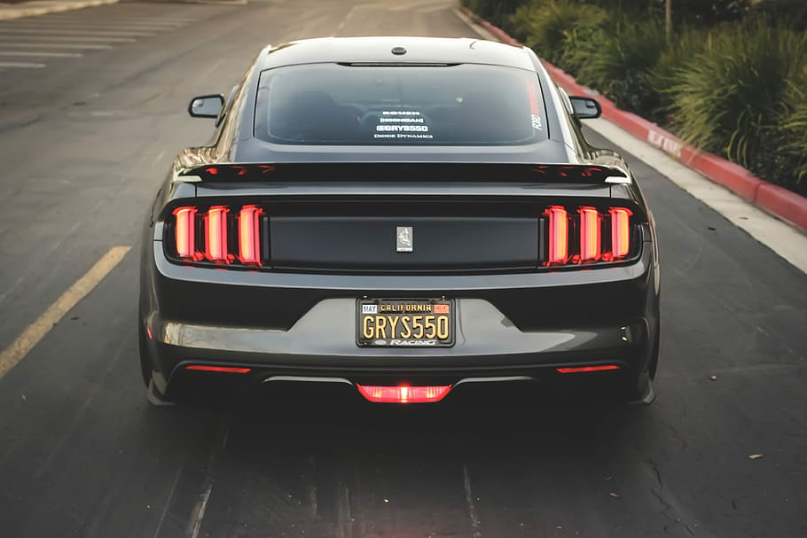
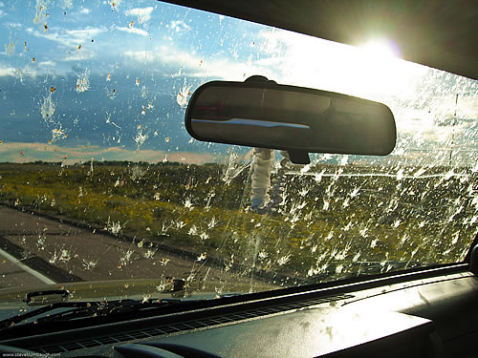
Tips to avoid rear-end accidents- cont’d.
Make sure your brake lights work: they give the vehicle behind you a warning of your intentions.
Keep your windows clean: Clear fields of vision are required so you can see what the other driver is doing and react accordingly.

Slide 12
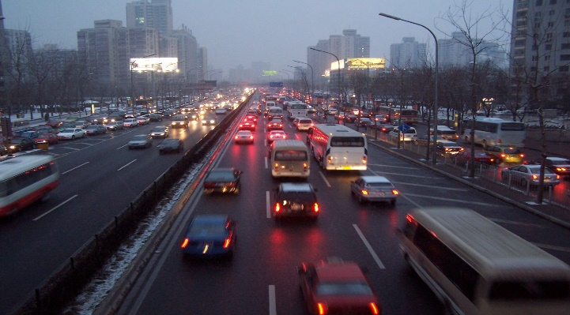
Tips to avoid rear-end accidents- cont’d.
Be aware of and avoid aggressive drivers: Try to move away as safely and quickly as possible.
Do not drive under the influence Drugs or Alcohol.
No driving if you are tired or ill.
Do not ride your brakes: The following vehicle can not determine your intentions.
Always wear your seatbelt.

Slide 13
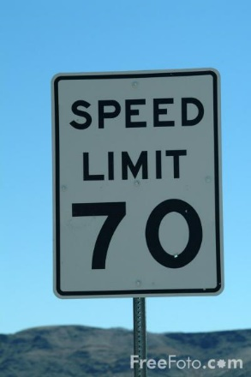
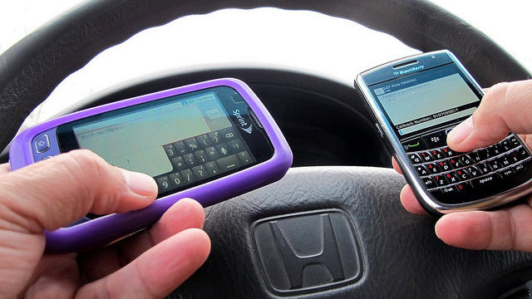
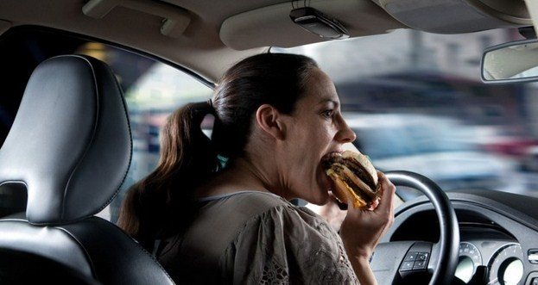
Tips to avoid rear-end accidents- cont’d.
Avoid distracting activities while driving: Examples include texting, using cell phone, reading, writing, eating, reaching for distant or moving objects etc.
Follow posted speed limits: Remember to adjust for adverse conditions.

Slide 14
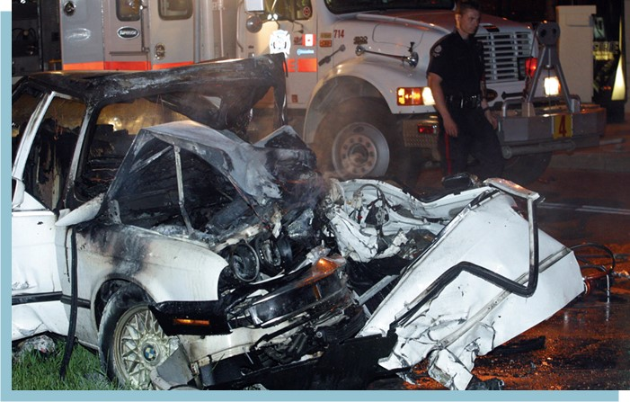
Avoid Rear-End Collisions
Following the tips that have been presented, you will decrease the chances of being involved in a rear-end accident, and if you are in a rear-end accident the tips will increase your chances of survival!

