Slide 1
E-Verify
Employment Eligibility Verification
Andrea Hubbard, OSUP

Slide 2
ACT 402 of 2011
PROVIDES THAT AN EMPLOYER SHALL NOT BE SUBJECT TO PENALTIES IF:
Each employee has been verified through the federal E-Verify system, or
Each employee has provided picture ID and one of the following:
U.S. Birth Certificate or certified birth card
Naturalization Certificate
Certificate of Citizenship
Alien Registration Receipt Card
U.S. Immigration form I-94 (with employment authorized stamp)

Slide 3
What is E-Verify?
A no cost internet based system that electronically verifies the employment eligibility of newly hired employees
Partnership between the U.S. Department of Homeland Security and the Social Security Administration
Offers automatic results for employers
Returns over 98% of employees as “work authorized”

Slide 4
What is E-Verify?
An extension of the I-9 process
Information from the I-9 must be entered into E-Verify no later than the 3rd business day after the employees’ start date

Slide 5
LaGov HCM Paid Agencies Are Required to Participate in E-Verify no later than 01/01/2012

Slide 6
Enrolling in E-Verify
All Agencies Paid through LaGov HCM
Will Use the Same Employer Identification Number (Tax ID)
72-1447520

Slide 7
Enrolling in E-Verify
Agencies will enroll as an Employer and set up a Program Administrator for program oversight
Each employer will be assigned a unique E-Verify number.
E-Verify requires each account to have at least one program administrator user.
All program administrators for that employer can view all user information under that number.

Slide 8
Website to Enroll
https://e-verify.uscis.gov/enroll/
The enrollment process must be completed in a single web session.
Enrollment time = 15-30 minutes

Slide 9
User Types and Roles
Program Administrators
(2 or more recommended by OSUP)
Register new users
Create E-Verify cases
View reports
Reset passwords
Update own profile
General Users (Optional)
Create E-Verify cases
View reports
Update own profile

Slide 10
Setting up Program Administrators and General Users
E-Verify structure should be based on your agency’s organization
Questions to ask:
Centralized or decentralized?
How many users?
Internal procedures to develop?

Slide 11
E-Verify MOU
Memorandum of Understanding (MOU) is a legal agreement between DHS, SSA & your agency.
Each E-Verify account requires an MOU.
HR Director or someone at an equal or higher level must electronically sign MOU.

Slide 12
ENROLLMENT PROCESS OVERVIEW

Slide 14
E-Verify Enrollment: Checklist Before You Enroll, You Must Decide:
Who will electronically sign the E-Verify memorandum of understanding (MOU) on behalf of your agency?
Which hiring sites will participate in E-Verify?
Which agency location(s) will access E-Verify?
Who in your agency will have access to E-Verify?
Who in your agency should be program administrators?

Slide 15
E-Verify Enrollment: Checklist To Enroll, You Will Need to Know:
Contact information for your agency’s E-Verify memorandum of understanding (MOU) signatory (name, phone number, fax number and e-mail address)
Agency’s name
The physical address of the location from which your agency will access E-Verify
Agency’s mailing address (if different from the physical address)
Employer Identification Number: 72-1447520 for LaGov HCM Paid Agencies
Total number of employees for all of your agency’s hiring sites that will participate in E-Verify (you’ll choose from a range of numbers)
The first three digits of your agency’s primary North American Industry Classification System (NAICS) code
The number of hiring sites that will participate in E-Verify

Slide 16
E-Verify Enrollment: Checklist For All Registering Users, You Must Provide:
Name
Phone Number
Fax Number (optional)
E-mail Address

Slide 17
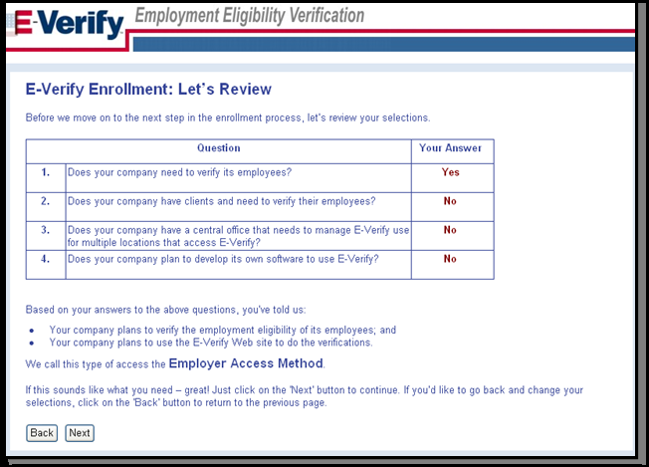
Review and Confirm Access Method

Slide 18
Select Your Organization Designation

Slide 19
Review and Agree to the MOU

Slide 20
Enter MOU Signatory Information

Slide 21
Enter Company (Agency ) Profile

Slide 22
Enter or Select North American Industry Classification System (NAICS) Code

Slide 23
Provide Hiring Site Information

Slide 24
Register E-Verify Program Administrators

Slide 25
Review and Certify Information

Slide 26
After Enrollment
Must verify all newly hired employees no later than the 3rd business day after the employee’s start date
E-Verify cannot be used as pre-screening tool for applicants

Slide 27
After Enrollment
Must display 2 required posters
Each user will receive an email confirmation
Username
Temporary password
E-Verify User Manual
Tutorial

Slide 28
After Enrollment
Refer to OSUP Memorandum #2012-08, issued September 16, 2011
(http://www.doa.louisiana.gov/osup/memo_index12.htm)
Required documentation to send to OSUP:
OSUP E-Verify Enrollment Form (OSUP/F96)
Signature page of MOU
E-Verify print out of agency’s profile information

Slide 29
E-Verify Resources and Contact Information
General information about E-Verify
Program information and statistics
Frequently asked questions
E-Verify user manuals & reference guides
Educational videos plus free webinars
Information about employee rights and employer obligations

Slide 30
E-Verify Customer Support
888-464-4218
877-875-6028 (TTY)
E-Verify@dhs.gov

Slide 31
OSUP Contact Information
Benefits & Financial Administration Unit
phone: (225) 342-0713
fax: (225) 219-4432
_doa-osup-bfa@la.gov

Slide 32
LaGov HCM Enhancements
Infotype 0094 (Residence Status)
Infotype 0019 (Monitoring of Tasks)

Slide 33
Sign Up to Receive OSUP Correspondence
Subscribe to the LaGOV ERP - Human Resources (HR) Employee Administration list at the following web address:
http://www.doa.louisiana.gov/ois/electronicnotifications.htm

Slide 34
QUESTIONS

