Slide 1


Home and Personal
Safety
Notes:
Thank you for including me…
My background – over 25 years of commercial Property and Casualty insurance experience, specializing in marketing, product development, and the utilization of client-facing technologies.
Began career with Willis, then was with Sedgwick which became Marsh, then spent the last 15 years with WGA and came into Gallagher as a merger partner in 2015.
Beyond all my marketing years, I was a producer while at Marsh and when I started at WGA, making me uniquely qualified to know what it takes for all of you to get the kind of opportunities I want to work on with you.

Slide 2

Stay Safe at Home
Home safety is an important topic that needs to be “top of mind” in every household. Learn and follow important safety tips to help keep yourself and your family members as safe as possible at all times.

Slide 3
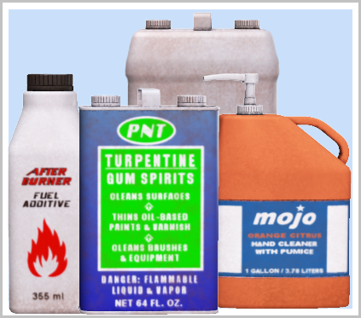
Household Chemical Safety
Most homes have cleaning solutions and other household chemicals that have the potential to be harmful to humans and/or pets if ingested or as a result of exposure.

Slide 4
Household Chemical Safety (cont.)
Keep all chemical solutions tightly sealed.
Do not remove chemical solutions from their original containers.
Do not store chemicals in the same areas where food, beverages, or medicine is stored.
Store chemicals in a secure area that cannot be accessed by children or pets.
Keep the poison control phone number handy in case of problems: 1-800-222-1222.
Keep Safety Data Sheets (SDS) on hand for the chemicals in your home so you know what to do as a result of exposure.

Slide 5

Fire Safety
Every family should be concerned about the dangers of fire. Take steps to make sure that you are prepared if such a situation occurs.

Slide 6
Fire Safety (continued)
Install smoke detectors in your kitchen, garage, all bedrooms, and other areas of the home where appropriate, being sure they are installed on each level of your home.
Test smoke detectors regularly and change batteries when you set the clock forward and back each spring and fall.
Place fire extinguishers in key areas throughout your home (kitchen, bedrooms, garage, other areas as dictated by your habits) and ensure that household members know how to use them.

Slide 7
Fire Safety (continued)
Establish a fire evacuation plan and be sure that everyone in your household knows what it is; practice via periodic fire drills.
If you have a two- or three-story home, be sure that portable fire escape ladders are accessible from upstairs rooms.
Make sure your street address is clearly visible from the street in case fire fighters (or other emergency service providers) need to be able to find your home.

Slide 8
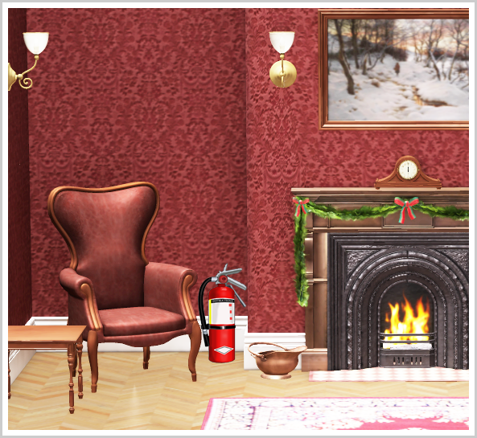
Fire Prevention
It is, of course, also important to take steps to minimize the risks of fire in your home by following appropriate fire prevention tips.

Slide 9
Fire Prevention (continued)
Do not leave the stove, oven, iron, grill, or other similar items unattended when they are turned on.
Avoid placing space heaters or candles near fabric, bedding, or anything flammable. Keep these items away from areas where they can be reached or knocked over by children or pets.
Only use space heaters in areas that are properly ventilated.
Store matches and lighters in secure areas out of reach of children.

Slide 10
Fire Prevention (continued)
Store filled gasoline containers, firewood, and any other explosive or combustible items away from your home or attached garage.
Have your heating system and fireplace serviced at the end of each summer so you can be sure they are safe to operate before the temperatures dip.
Keep your yard free of dead vegetation, twigs, straw, leaves, etc., as these items can pose fire risks.
Be sure to keep the lid on your trash can closed.

Slide 11
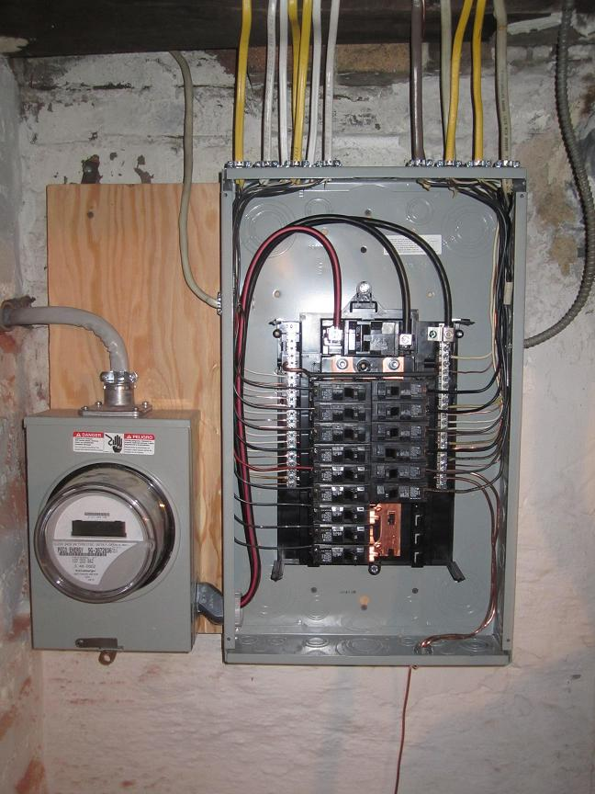
Electrical Safety
Safety concerns associated with electricity are related to both fire safety and personal safety. Take care to avoid electrical problems that could result in fires or cause injury to members of your household.

Slide 12
Electrical Safety (continued)
Use extension cords only as directed, being careful not to exceed recommended wattage.
Do not place power cords under rugs or coil them up while in use.
Make sure that all of the outlets used by your appliances are grounded.
Regularly check ground fault circuit interrupters (GFCI).
Place covers over electrical outlets that are not in use.
Never cut or alter a plug in order to get it to fit into an electrical outlet.

Slide 13
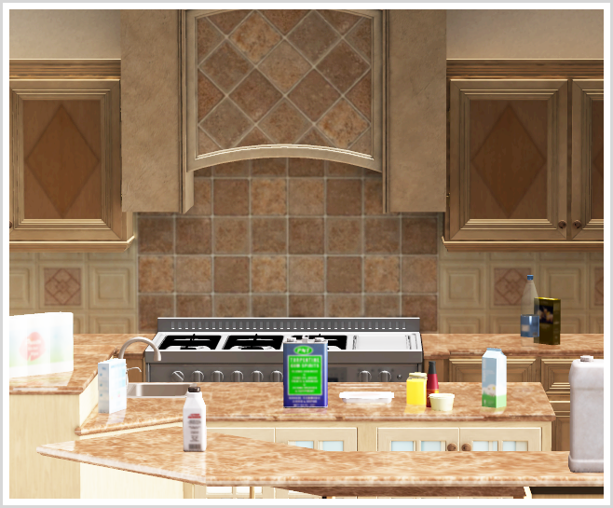
Kitchen Safety
Most people spend more time in the kitchen than in any other room of the home. With all of the potential safety risks in this room, it deserves special attention in any discussion of home safety.

Slide 14
Kitchen Safety (continued)
Store all sharp cooking utensils and serving ware in locations that cannot be easily accessed by children.
Make sure that knives are placed in storage areas with the blades pointing to the back, so the first thing you touch when reaching in is the handle.
Keep your refrigerator between 34 and 40 degrees Fahrenheit.
Keep your freezer between -10 and -20 degrees Fahrenheit.

Slide 15
Kitchen Safety (continued)
Avoid thawing frozen food at room temperature, instead allowing it to thaw in the refrigerator or using your microwave.
Do not use food products past their expiration date, being aware that foods spoil more rapidly once they have been opened.
Install child proofing devices on cabinets if you have young children or pets who are able to get into cabinet doors.

Slide 16
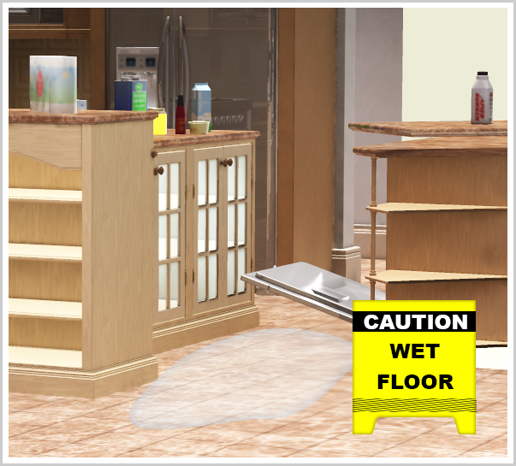
Slip and Fall Safety
Many home injuries occur as a result of slips, trips and falls. Take steps to reduce this significant risk in your household.

Slide 17
Slip and Fall Safety (continued)
Ensure that each room of your home has proper lighting.
Ensure all interior and exterior stairway handrails are firmly affixed to the wall.
Make sure throw rugs are firmly affixed to the floor, or remove them.
Place “wet floor” signs out when areas are drying as a result of being mopped or having something spilled on them.

Slide 18
Slip and Fall Safety (continued)
Periodically check door thresholds to ensure they are firmly held in place and that the flooring beneath them is not loose or fraying.
Get each household member in the habit of picking up after themselves so that items aren’t left on the floor in trafficked areas.
Alert household members about the importance of keeping walkways clear so they’ll pick up any items they see in the way, not just ones they are personally responsible for.
Avoid leaving electrical cords in areas where people walk.

Slide 19
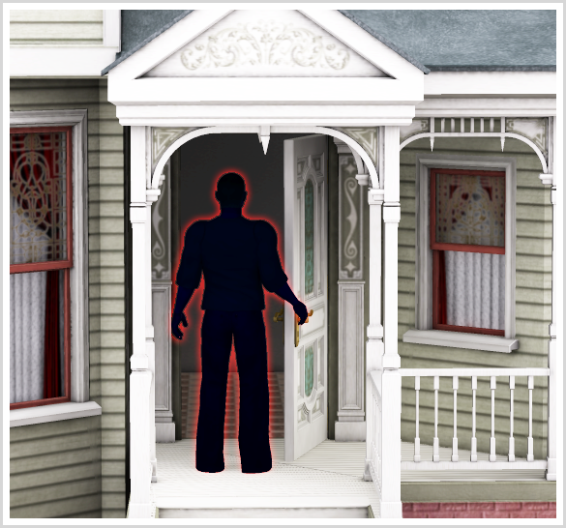

Home Invasion Safety
Takings steps to prevent your home from being targeted by burglars is an important part of any comprehensive approach to home safety.

Slide 20
Home Invasion Safety (continued)
Do not leave keys to your home under the doormat, hanging on nails, placed in potted plants, or any other areas outside your home.
When having your car serviced, do not leave your entire key ring; instead only give the key to your vehicle to the service technician.
Install peep holes in your doors so that you never have to open the door without being sure of who is on the other side.
Consider installing a burglar alarm system.
Avoid leaving notes on the door alerting friends, delivery drivers, etc. that you are not in and when you expect to return.

Slide 21
Home Invasion Safety (continued)
Don’t allow mail and newspapers to pile up when you are out of town; have someone gather them for you if you are going to be away.
Turn down the ringer on your home phone when you are out so that a loud, unanswered phone does not alert potential intruders that the property is empty.
Do not leave valuables lying around or in areas where they are visible through doors or curtains.
Keep the doors and windows to your home closed and locked when you are not using them and when you are not at home.
Plant shrubs beneath your windows to make it difficult for potential burglars to gain access through windows.
Keep your garage door pulled down.

Slide 22

Gardening
Wear safety glasses/goggles, sturdy shoes and long pants.
Wear hearing protection when using machinery.
Wear gloves to lower risk for skin irritations, cuts
and certain contaminants.
Protect yourself from mosquitoes and ticks, use DEET, wear long sleeved shirts and pants.
Minimize risk of sunburn and skin cancer, wear wide-brimmed hats, sun shades, and sun screen.

Slide 23

Boating
When taking the family out for a boating remember to only allow experienced operators to control the vessel. Pay attention, don’t be reckless and don’t speed.
Some other tips to follow:
Have a Fire extinguish on board.
Make sure boat lights are operable.
Take emergency supplies : phone, flares, first aid kits etc.
Don’t overload boat with people or equipment.
Make sure all passengers have a personal floatation device available.
Never use alcohol or drugs before or during boat operations.
Make someone on-shore aware of where you are going and expected
return time.

Slide 24
More General Safety Tips
Gas exposure - If your home uses natural gas, be sure you have working carbon monoxide detectors installed.
Medication - Do not store medicine in the same areas as food and keep medications out of reach of children.
Furniture - Ensure bookshelves and other tall potentially tipping furniture pieces are affixed to the wall or secured in other ways.
CPR - Consider having adults and teens in your household become certified in cardio pulmonary resuscitation (CPR).

Slide 25

You Can’t Be Too Careful
When it comes to keeping yourself and your family safe, it’s not possible to be too careful. These are just a few of the important safety tips and guidelines that you may want to consider following in your home.
Be proactive in continually improving home safety in your dwelling, including doing regular safety check-ups and engaging in ongoing education to teach each family member what he or she can do to make a difference.

