Slide 1


2025 Capital Outlay Seminar
For NON-State Agencies
WELCOME!
We will be starting soon….

Slide 2
2025 Capital Outlay Seminar
For NON-State Agencies
Office of Facility Planning and Control
Margaret Hill, Capital Outlay Administrator

Slide 3
objectives
Explain what qualifies as a Capital Outlay expenditure
Provide an overview of the phases of the Capital Outlay process
Explain the information required in a Capital Outlay Request (COR)
Explain the difference between an appropriation and funding
Explain General Obligation Bond priorities

Slide 4
What are Capital Outlays?
Per Title 39:2 (9)……
Land
Buildings
Equipment
Permanent Properties
Preservation or Development or Permanent Improvement

Slide 5
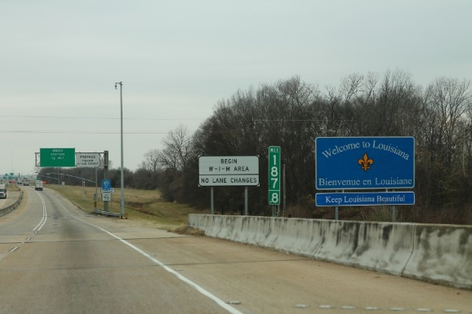
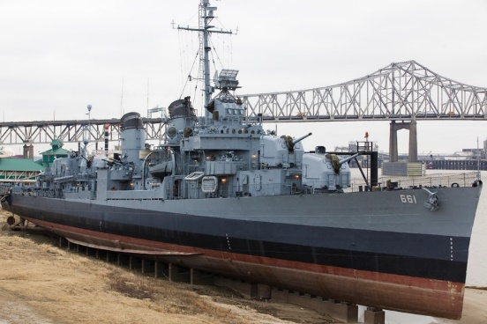
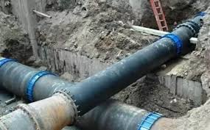
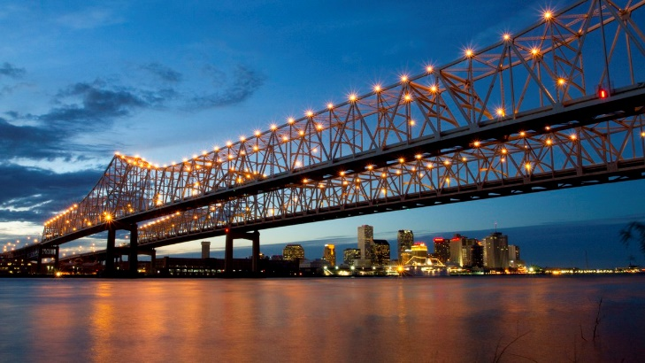
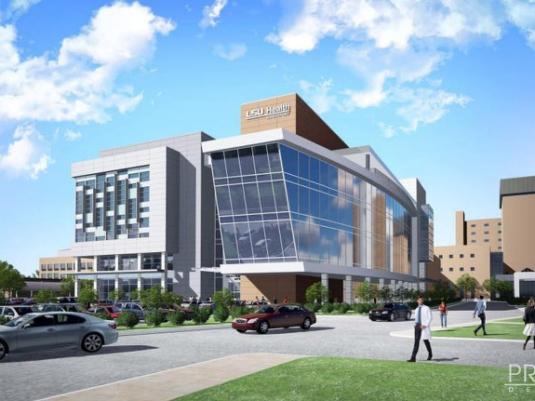
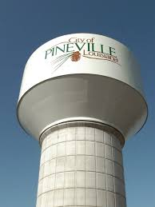
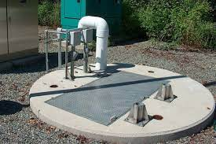
Examples of Projects that Qualify?

Slide 6

When Will Funding Become Available?
Nov 2025
July 2026
Sept 2026
Oct 2026
Nov 2026
Funds Requested
Funds Appropriated
FUNDING TIMELINE
Project Funded
Funds Available
Select Designer

Slide 7

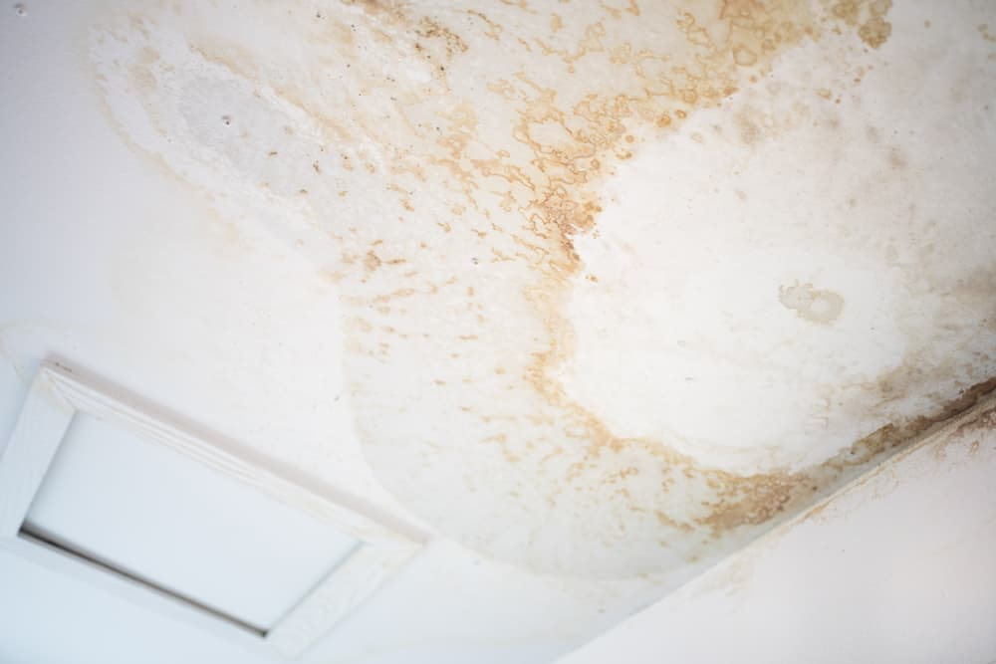
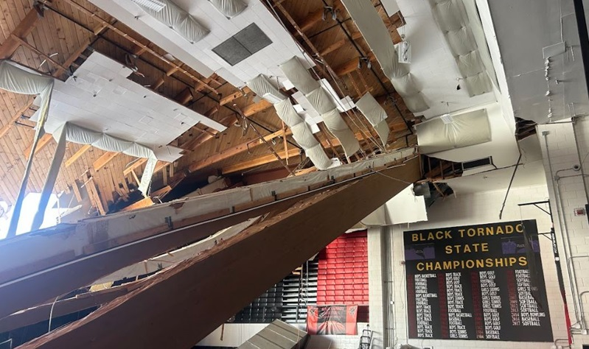
Plan Ahead
Capital Outlay is not intended to be a quick fix!
Don’t let this…………..
Become this……….

Slide 8

Advancing a capital outlay project
Submit a Capital Outlay Request
Receive Appropriation in the Capital Outlay Act
Receive Funding of the Appropriation
CEA Executed
Select Designer/Proceed with Construction
Close-out
Completed Project

Slide 9
The capital outlay process
Development
Execution
Enactment
  The process of developing, enacting and executing the state capital outlay budget

Slide 10
The capital outlay process:
Development
Development
Begins with the submission of Capital Outlay Requests (CORs)
FPC reviews the CORs for compliance with statutory requirements
DOA develops an initial budget which becomes the Capital Outlay Bill, Original House Bill 2

Slide 11
How do I Apply for Capital Outlay Funding?
Requests are submitted electronically through the eCORTS systems
Requests must be submitted by 11:59 pm, November 1st each year (For FY26-27, Saturday, November 1st)
A request is required to be updated if new funding is needed or if contracts have not been issued within 24 months of the deadline
Requests must include certain statutorily required information

Slide 12
Statutorily required information
an analysis of need with corroborative data,
the cost of opening and operating the facility for the first year,
a reasonable estimate of the date when the project will be needed,
the estimated annual operating and maintenance costs, and the method and source of financing for each of the next five years,
the project's proposed location,
the estimated completion date of the project,
the estimated construction cost,
identification and description of other similar facilities and projects in the given area, and
the estimated local match requirement and amount of local funds expended on the project (Non-State only),
the order of priority.
the cost of equipping and furnishing the project,

Slide 13
ADDITIONAL Non-state requirements
A Legislative Letter of Support (LOS)
A Minimum 25% local match
Updated information on amount of match expended
✓
✓
✓

Slide 14
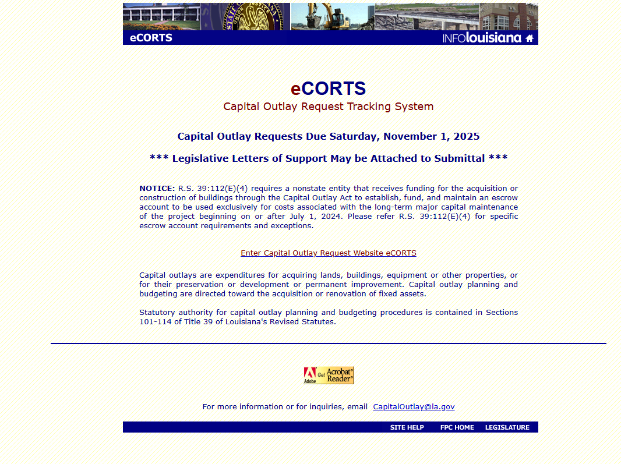
Ecorts system

Slide 15
The enactment phase
Enactment
Governor submits Original House Bill 2 to the legislature by the 8th day of the legislative session
Legislature amends the Bill
Governor signs the Bill
The Bill becomes “the Act”

Slide 16
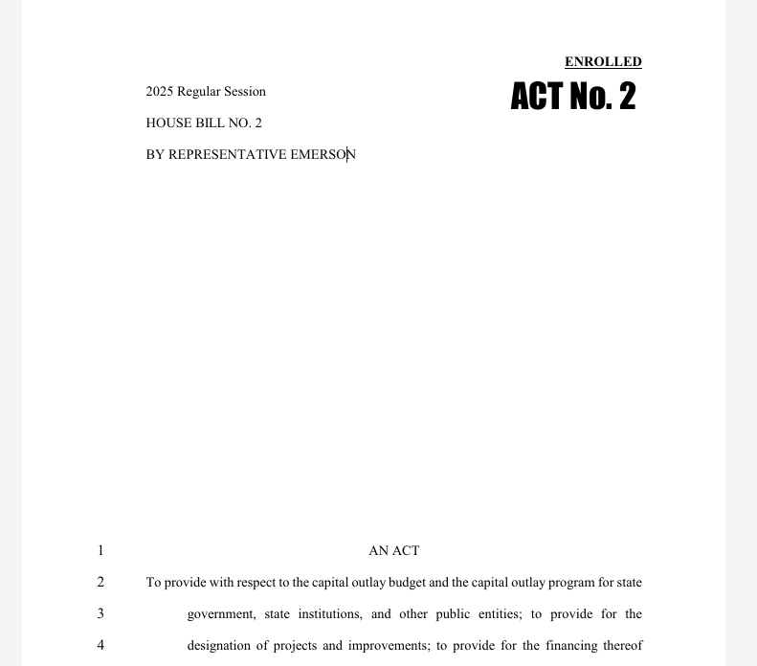
Following bill enactment

Slide 17
What type of appropriation did I receive?
General Obligation Bonds
Cash
OR
Must be approved by the State Bond Commission
Available once Governor signs the bill into Act

Slide 18
What do you mean by cash?
State General Fund (Direct)
State General Fund (Direct) Non-Recurring Revenues
Capital Outlay Savings Fund
Re-appropriated Cash
Re-Appropriated Bond Proceeds
**Cash is disbursed as expenditures are made on a project**

Slide 19

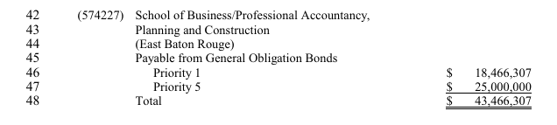
Example of appropriations
Project ID
Appropriation Source

Slide 20
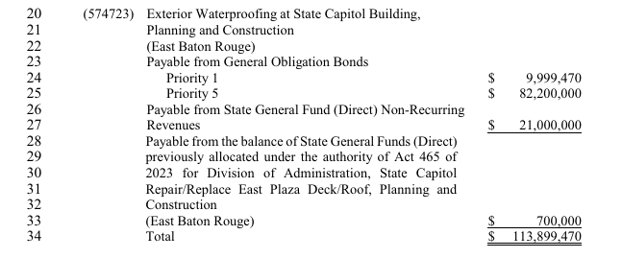
Example of appropriations, contd.
********Appropriations are made to a specific entity for a specific purpose.***********

Slide 21
Appropriated vs funded
Being in the Act
is NOT the same as receiving funding

Slide 22
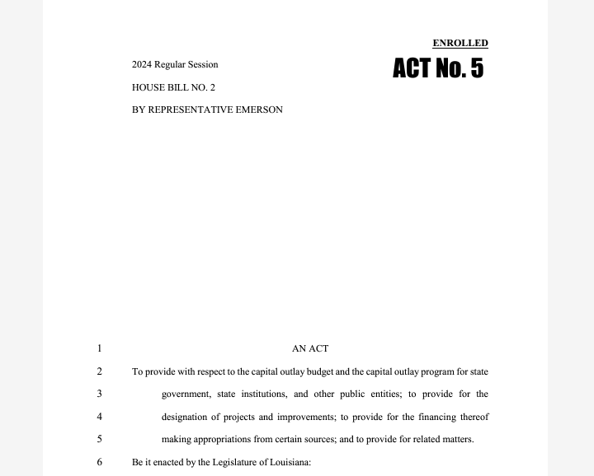


Appropriated vs funded, contd.
Appropriations Authority to Receive Funding
Funding Commitment of funds

Slide 23
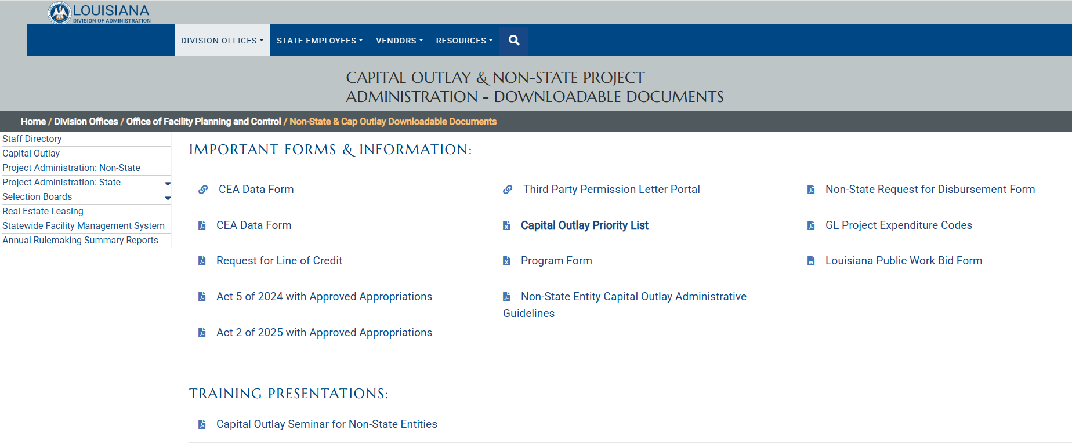
reference
On the FPC Website: https://www.doa.la.gov/doa/fpc/non-state-cap-outlay-downloadable-documents/

Slide 24
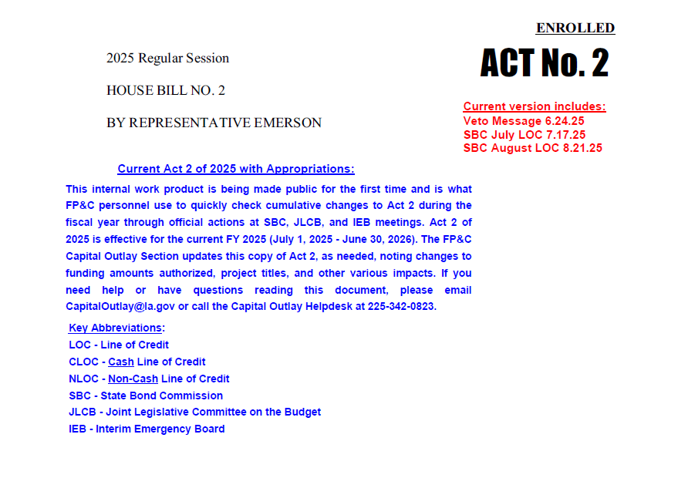
Approved appropriations

Slide 25
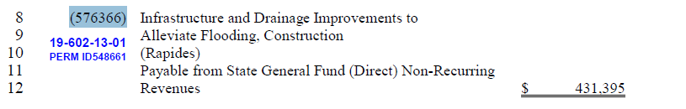
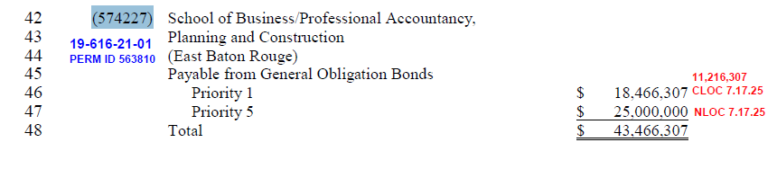
Example of funding
FPC Schedule #
Based on 1st Year Requested
Date and Amount approved by SBC if not total

Slide 26
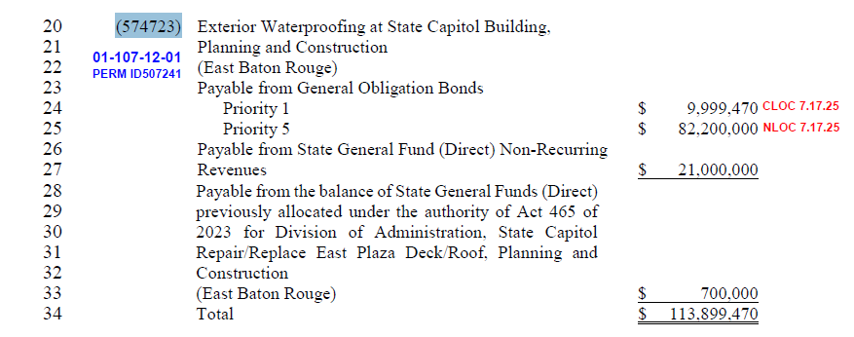
Example of funding, contd.

Slide 27
General obligation bond appropriation
General Obligation Bonds
  Priority 1 | Cash Appropriation | Reauthorized
  Priority 2 | Cash Appropriation | New
  Priority 3 | Cash Appropriation | New
  Priority 4 | Cash Appropriation | New
  Priority 5 | Non-Cash Approp. | New / Reauthorized

Slide 28
Priority 1
Always a reauthorization of appropriations
with PRIOR lines of credit
Priority 2 Approved in Previous Year
Priority 1 Approved in Previous Year
Priority 3
Priority 1
Priority 5 Approved in Previous Year
Priority 4

Slide 29
Priority 2
New authorization for CASH to be spent in the fiscal year of the Act
Must receive a cash line of credit from SBC in the year it is appropriated in order for it to be considered approved funding for the project
New Priority 2
Priority 1
Priority 3
Priority 1
Priority 5
Priority 4

Slide 30
Priority 3 & 4
New authorization for CASH to NOT be spent in the fiscal year of the Act
Priority 3 and Priority 4 are considered for funding after Priority 1 and Priority 2, limited capacity makes Priority 3 and Priority 4 rare.
Priority 2
Priority 1
Priority 3
Priority 1
Priority 5
Priority 4

Slide 31
Priority 5
New or reauthorized BUDGET AUTHORITY
Can only be granted a NONCASH line of credit, cannot be expended
Must be re-authorized by SBC each year
Priority 2
Priority 1
Priority 3
Priority 1
Priority 5
Priority 4

Slide 32
What to expect after legislative session
Appropriations Memos are distributed
CEA are processed if project is new
General Obligation Bond appropriations are considered for funding
Lines of Credit are granted by the State Bond Commission
Notification of Line of Credit Status Memos are distributed

Slide 33


Contact capital outlay staff
http://www.doa.louisiana.gov/fpc/fpc.htm
Email: CapitalOutlay@la.gov
Phone: 225.342.0823
Jordyn Major, Capital Outlay Manager
Marc Parenti, Analyst
Meagan Sibley, Analyst
Derrick Angelloz, Analyst
Heather Barker, Capital Outlay Admin

